Slide 1


PREDICTING IF THE WATER IS SAFE TO DRINK
Sameer Nepal
DSC 680

Slide 2


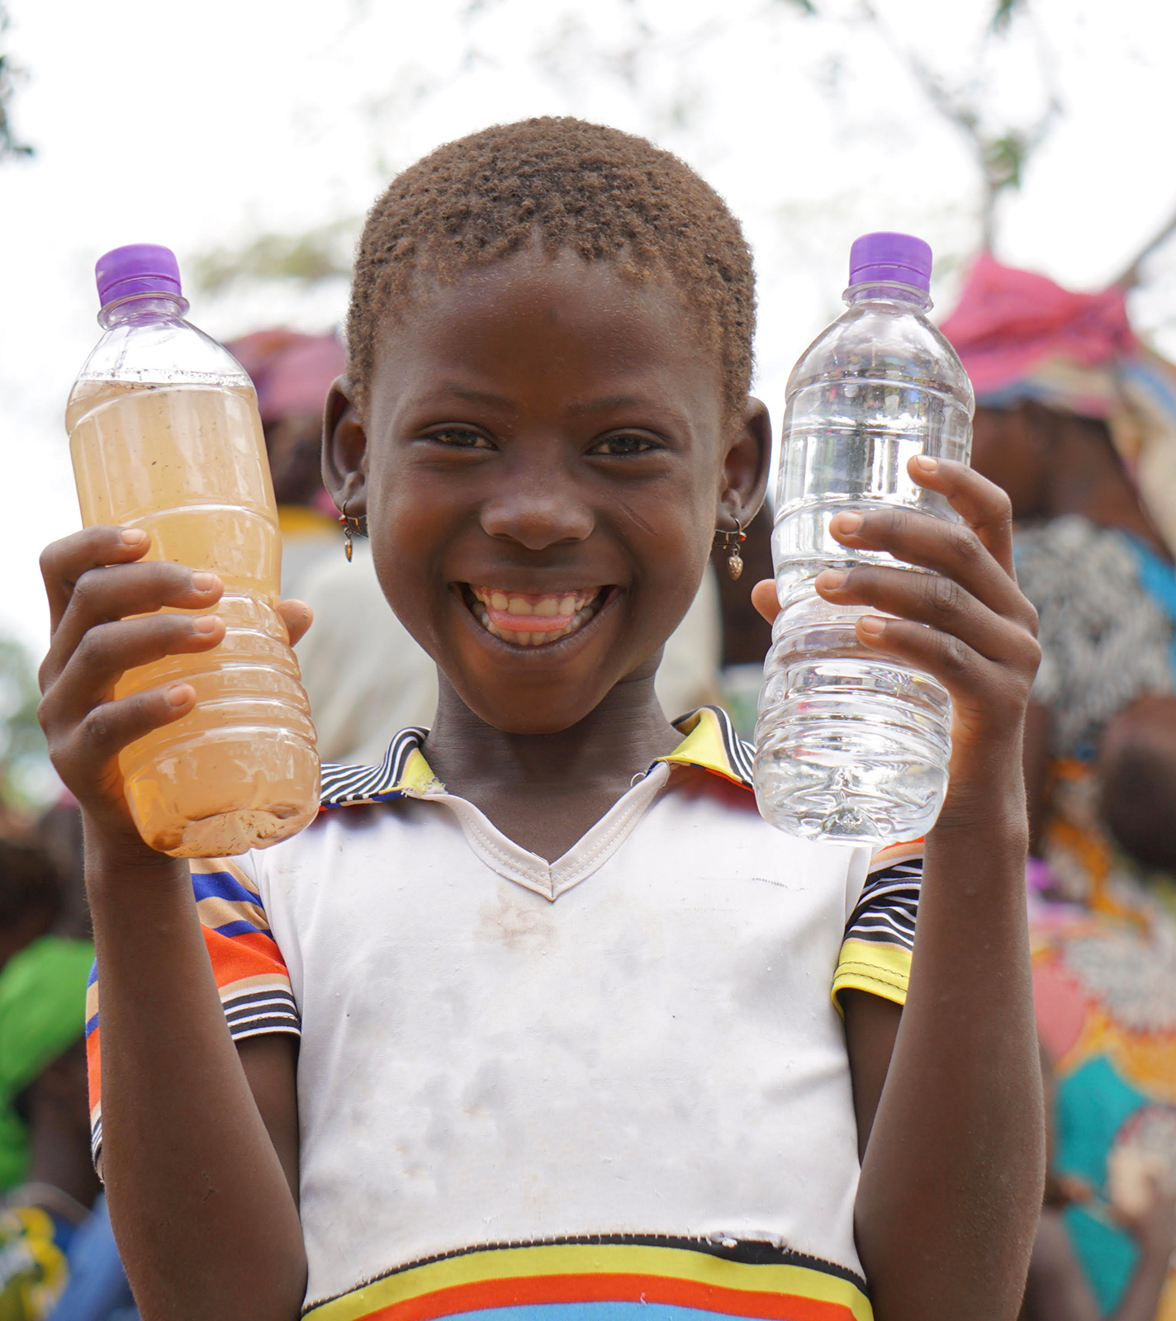
Business Problem

Slide 3
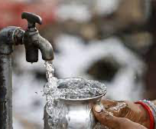
Introduction
Per WHO, almost 10 % of population do not have access to safe drinking water
There can be many impurities like physical, chemical, biological, and radiological
Low and medium income country are mainly affected
Chemicals present in drinking water can result in various chronic illnesses, such as cancer and cardiovascular disease

Slide 4

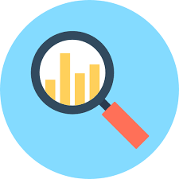
Data Description
Kaggle
Independent Variables: Several minerals present in water
Dependent Variable: Classification of water as safe or not
Imaginary Data for proof of concept
Imbalanced data set

Slide 5
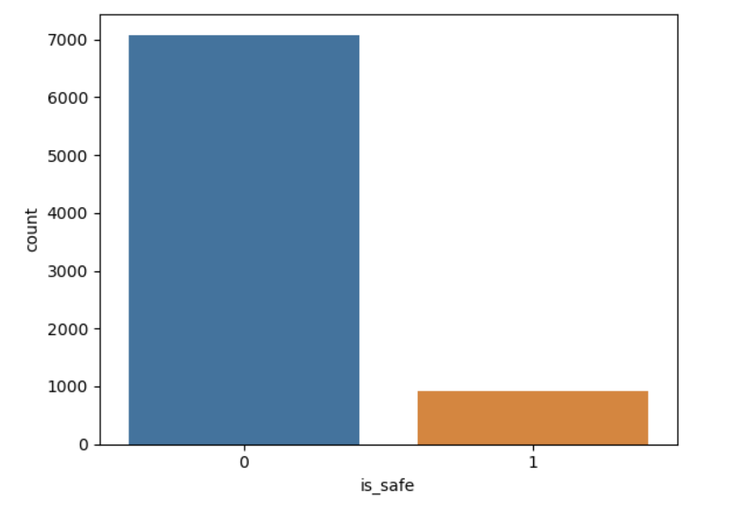
Exploratory Data Analysis ( EDA )
Checking for nulls
Conversion of string to numeric
Distribution of target variable
Balancing the dataset
Correlation Matrix

Slide 6
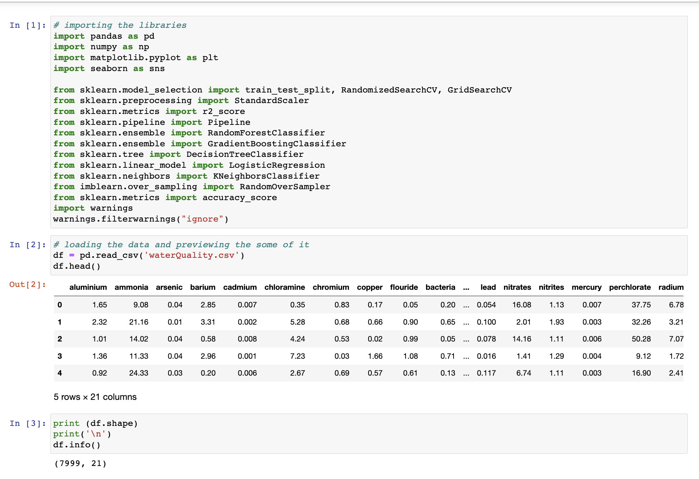
Code Snippet

Slide 7
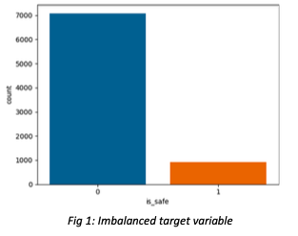
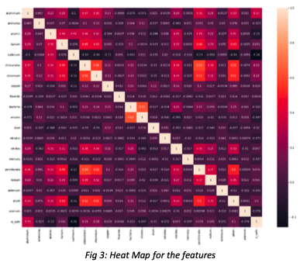
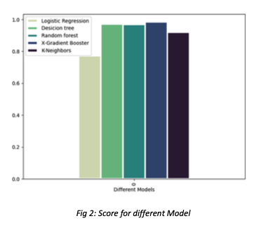
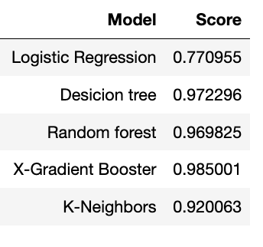
Analysis and Modeling

Slide 8

Conclusion
Imaginary data
Educational Purpose
Accuracy for model is very high
Make the community healthy

